Slide 1
Requirements Analysis and Specification
Many projects fail:
  because they start implementing the system without determining whether they are building what the customer really wants.

Slide 2
Requirements Analysis and Specification
Goals of requirements analysis and specification phase:
  fully understand the user requirements
  remove inconsistencies, anomalies, etc. from requirements
  document requirements properly in an SRS document

Slide 3
Requirements Analysis and Specification
Consists of two distinct activities:
    Requirements Gathering and Analysis
    Specification

Slide 4
Requirements Analysis and Specification
The person who undertakes requirements analysis and specification:
  known as systems analyst:
  collects data pertaining to the product
  analyzes collected data:
    to understand what exactly needs to be done.
  writes the Software Requirements Specification (SRS) document.

Slide 5
Requirements Analysis and Specification
Final output of this phase:
  Software Requirements Specification (SRS) Document.
The SRS document is reviewed by the customer.
  reviewed SRS document forms the basis of all future development activities.

Slide 6
Requirements Gathering
Analyst gathers requirements through:
  observation of existing systems,
  studying existing procedures,
  discussion with the customer and end-users,
  analysis of what needs to be done, etc.

Slide 7
Requirements Gathering (CONT.)
In the absence of a working system,
  lot of imagination and creativity are required.
Interacting with the customer to gather relevant data:
  requires a lot of experience.

Slide 8
Requirements Gathering (CONT.)
Some desirable attributes of a good system analyst:
  Good interaction skills,
  imagination and creativity,
  experience.

Slide 9
Analysis of the Gathered Requirements
After gathering all the requirements:
  analyze it:
    Clearly understand the user requirements,
    Detect inconsistencies, ambiguities, and incompleteness.
Incompleteness and inconsistencies:
  resolved through further discussions with the end-users and the customers.

Slide 10
Inconsistent requirement
Some part of the requirement:
  contradicts with some other part.
Example:
  One customer says turn off heater and open water shower when temperature > 100 C
  Another customer says turn off heater and turn ON cooler when temperature > 100 C

Slide 11
Incomplete requirement
Some requirements have been omitted:
  due to oversight.
Example:
  The analyst has not recorded:
  when temperature falls below 90 C
    heater should be turned ON
    water shower turned OFF.

Slide 12
Analysis of the Gathered Requirements (CONT.)
Requirements analysis involves:
  obtaining a clear, in-depth understanding of the product to be developed,
  remove all ambiguities and inconsistencies.

Slide 13
Analysis of the Gathered Requirements(CONT.)
Several things about the project should be clearly understood by the analyst:
  What is the problem?
  Why is it important to solve the problem?
  What are the possible solutions to the problem?
  What complexities might arise while solving the problem?

Slide 14
Analysis of the Gathered Requirements(CONT.)
After collecting all data regarding the system to be developed,
  remove all inconsistencies and anomalies from the requirements,
  systematically organize requirements into a Software Requirements Specification (SRS) document.

Slide 15
Software Requirements Specification
Main aim of requirements specification:
  systematically organize the requirements arrived during requirements analysis
  document requirements properly.

Slide 16
Software Requirements Specification
The SRS document is useful in various contexts:
  statement of user needs
  contract document
  reference document
  definition for implementation

Slide 17
Software Requirements Specification: A Contract Document
Requirements document is a reference document.
SRS document is a contract between the development team and the customer.
  Once the SRS document is approved by the customer,
    any subsequent controversies are settled by referring the SRS document.

Slide 18
Software Requirements Specification: A Contract Document
Once customer agrees to the SRS document:
  development team starts to develop the product according to the requirements recorded in the SRS document.
The final product will be acceptable to the customer:
  as long as it satisfies all the requirements recorded in the SRS document.

Slide 19
SRS Document (CONT.)
The SRS document is known as black-box specification:
  the system is considered as a black box whose internal details are not known.
  only its visible external (i.e. input/output) behaviour is documented.
Input Data
S
Output Data

Slide 20
SRS Document (CONT.)
SRS document concentrates on:
  what needs to be done
  carefully avoids the solution (“how to do”) aspects.
The SRS document serves as a contract
  between development team and the customer.
  Should be carefully written

Slide 21
SRS Document (CONT.)
The requirements at this stage:
  written using end-user terminology.
later a formal requirement specification may be developed from it.

Slide 22
Properties of a good SRS document
It should be concise
  and at the same time should not be ambiguous.
It should specify what the system must do
  and not say how to do it.
Easy to change.,
  i.e. it should be well-structured.
It should be consistent.
It should be complete.

Slide 23
Properties of a good SRS document (cont...)
It should be traceable
  you should be able to trace which part of the specification corresponds to which part of the design and code, etc and vice versa.
It should be verifiable
  e.g. “system should be user friendly” is not verifiable

Slide 24
SRS Document (CONT.)
SRS document, normally contains three important parts:
  functional requirements,
  Non functional requirements,
  constraints on the system.

Slide 25
SRS Document (CONT.)
It is desirable to consider every system:
  performing a set of functions {fi}.
  Each function fi considered as:
  transforming a set of input data to corresponding output data.
Input Data
Output Data
fi

Slide 26
Example: Functional Requirement
F1: Search Book
  Input:
    an author’s name:
  Output:
    details of the author’s books and the locations of these books in the library.
Author Name
Book Details
f1

Slide 27
Functional Requirements
Functional requirements describe:
  A set of high-level requirements
  Each high-level requirement:
    takes in some data from the user
    outputs some data to the user
  Each high-level requirement:
    might consist of a set of identifiable functions

Slide 28
Functional Requirements
For each high-level requirement:
  every function is described in terms of
    input data set
    output data set
    processing required to obtain the output data set from the input data set

Slide 29
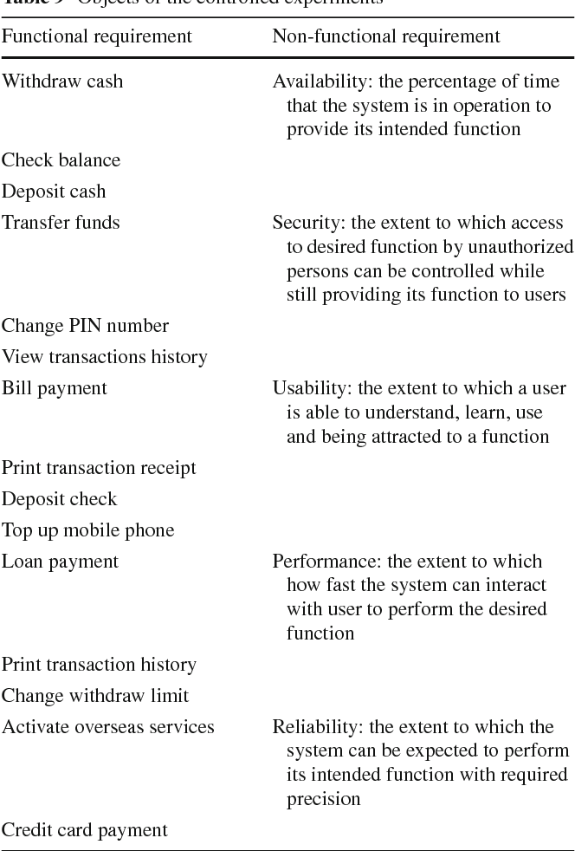

Slide 30
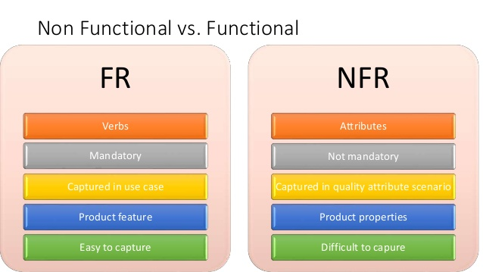

Slide 31
Nonfunctional Requirements
In addition to the obvious features and functions that you will provide in your system, there are other requirements that don't actually DO anything, but are important characteristics nevertheless. These are called "non-functional requirements" or sometimes "Quality Attributes."
For example, attributes such as performance, security, usability, compatibility. aren't a "feature" of the system, but are a required characteristic.
You can't write a specific line of code to implement them, rather they are "emergent" properties that arise from the entire solution.

Slide 32
Non functional Requirements
Non functional requirements include:
Reliability: the extent to which it works as and when needed.
Performance: speed and throughput.
Security: accessible and usable only in authorized ways by authorized users.
Maintainability: speed and reliability of updating and/or correcting production products.

Slide 33
Non functional Requirements
Portability: ability and ease of using the solution in different configurations or environments.
Efficiency: taking minimal time, effort, resources or cost to create, or operating a solution.
Safety: not causing harm, injury or damage.

Slide 34
Constraints
Constraints describe things that the system should or should not do.
  For example,
    standards compliance
    how fast the system can produce results
      so that it does not overload another system to which it supplies data, etc.

Slide 35
Examples of constraints
Hardware to be used,
Operating system
  or DBMS to be used
Capabilities of I/O devices
Standards compliance
Data representations
  by the interfaced system

Slide 36
Organization of the SRS Document
Introduction.
Functional Requirements
Nonfunctional Requirements
  External interface requirements
  Performance requirements
Constraints

Slide 37
Example Functional Requirements
List all functional requirements
  with proper numbering.
Req. 1:
  Once the user selects the “search” option,
    he is asked to enter the key words.
  The system should output details of all books
    whose title or author name matches any of the key words entered.
    Details include: Title, Author Name, Publisher name, Year of Publication, ISBN Number, Catalog Number, Location in the Library.

Slide 38
Example Functional Requirements
Req. 2:
  When the “renew” option is selected,
    the user is asked to enter his membership number and password.
  After password validation,
    the list of the books borrowed by him are displayed.
  The user can renew any of the books:
    by clicking in the corresponding renew box.

Slide 39
Req. 1:
R.1.1:
  Input: “search” option,
  Output: user prompted to enter the key words.
R1.2:
  Input: key words
  Output: Details of all books whose title or author name matches any of the key words.
    Details include: Title, Author Name, Publisher name, Year of Publication, ISBN Number, Catalog Number, Location in the Library.
  Processing: Search the book list for the keywords

Slide 40
Req. 2:
R2.1:
  Input: “renew” option selected,
  Output: user prompted to enter his membership number and password.
R2.2:
  Input: membership number and password
  Output:
    list of the books borrowed by user are displayed. User prompted to enter books to be renewed or
    user informed about bad password
  Processing: Password validation, search books issued to the user from borrower list and display.

Slide 41
Req. 2:
R2.3:
  Input: user choice for renewal of the books issued to him through mouse clicks in the corresponding renew box.
  Output: Confirmation of the books renewed
  Processing: Renew the books selected by the in the borrower list.

Slide 42
Examples of Bad SRS Documents
Unstructured Specifications:
  Narrative essay --- one of the worst types of specification document:
    Difficult to change,
    difficult to be precise,
    difficult to be unambiguous,
    scope for contradictions, etc.
Forward References:
  References to aspects of problem
    defined only later on in the text.

Slide 43
Examples of Bad SRS Documents
Overspecification:
  Addressing “how to” aspects
  For example, “Library member names should be stored in a sorted descending order”
  Overspecification restricts the solution space for the designer.
Contradictions:
  Contradictions might arise
    if the same thing described at several places in different ways.

Slide 44
Summary
Requirements analysis and specification
  an important phase of software development:
  any error in this phase would affect all subsequent phases of development.
Consists of two different activities:
  Requirements gathering and analysis
  Requirements specification

Slide 45
Summary
The aims of requirements analysis:
  Gather all user requirements
  Clearly understand exact user requirements
  Remove inconsistencies and incompleteness.
The goal of specification:
  systematically organize requirements
  document the requirements in an SRS document.

Slide 46
Summary
Main components of SRS document:
  functional requirements
  Non functional requirements
  constraints

